Slide 1
FATIGUE, SLEEP, REST AND RECOVERY by shikha malhotra

Slide 2
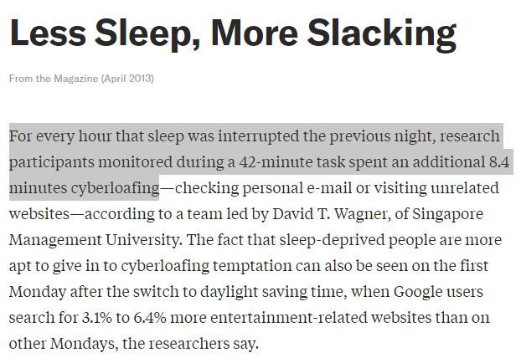

Slide 3
Are you getting your 7-9 hours?
Sleep
No Sleep
Consolidate and share memories
Process emotional experiences
Replenish glucose
Clear out beta amyloid
Greater resilience
Poor Judgement
Lack of self-control
Impaired creativity
Poor mood
Sleep Devaluation

Slide 4
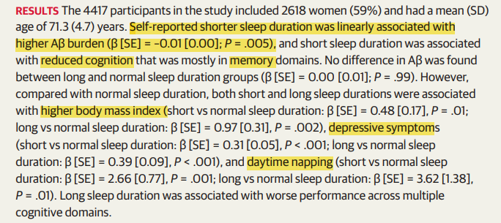
Notes:
https://jamanetwork.com/journals/jamaneurology/fullarticle/2783664

Slide 5
Sleep versus success
Making a small number of key decisions well is more important than making a large number of decisions. If you shortchange your sleep, you might get a couple of extra ‘productive’ hours, but that productivity might be an illusion – Jeff Bezos (Amazon CEO)
The math behind Jeff Bezos' 8 hours of sleep—and why 4 hours isn't worth it (cnbc.com)
“So, as we are facing all the multiple crises in our world at the moment, what is good for us on a personal level, what's going to bring more joy, gratitude, effectiveness in our lives and be the best for our own careers, is also what is best for the world. So, I urge you to shut your eyes and discover the great ideas that lie inside us; to shut your engines and discover the power of sleep.” – Arianna Huffington (co-founder of The Huffington Post, Founder and CEO of Thrive Global, Author)
Sleep Resources | Arianna Huffington
Albert Einstein
Warren Buffett
Bill Gates
The Dalai Lama
Sheryl Sandberg
Jennifer Lopez
Tim Cook
14 Highly Successful People Who Prioritize A Good Night's Sleep | HuffPost Life
Notes:
Nike, Google, Huffington Post and Time Warner

Slide 6
The well-known solutions
Consistent bedtime and wake-up schedule
Avoiding certain substances too close to bedtime
Caffeine within seven hours
Alcohol within three hours
Nicotine within three or four hours
Exercise (but not right before bed)
Relaxation rituals
Meditation
No blue light exposure at night (filters)
Sleep tracking
Tasks you can perform in sleep deprived state – Low consequence, routine tasks requiring minimal creativity
Formatting your presentations or papers
Organizing paperwork
Answering emails
Surveys

Slide 7
THE LESS KNOWN PROBLEMS
Sleep Apnea
Insomnia
Overweight
Thick neck
Snoring
Feeling tired after adequate sleep
Sleep study > CPAP
Cognitive Behavioral Therapy for Insomnia (CBT-I)
Stimulus control therapy
Sleep restriction
Sleep hygiene
Sleep environment improvement
Relaxation training
Remaining passively awake
Biofeedback
Available Online
Notes:
Stimulus control therapy. This method helps remove factors that condition your mind to resist sleep. For example, you might be coached to set a consistent bedtime and wake time and avoid naps, use the bed only for sleep and sex, and leave the bedroom if you can't go to sleep within 20 minutes, only returning when you're sleepy.
Sleep restriction. Lying in bed when you're awake can become a habit that leads to poor sleep. This treatment reduces the time you spend in bed, causing partial sleep deprivation, which makes you more tired the next night. Once your sleep has improved, your time in bed is gradually increased.
Sleep hygiene. This method of therapy involves changing basic lifestyle habits that influence sleep, such as smoking or drinking too much caffeine late in the day, drinking too much alcohol, or not getting regular exercise. It also includes tips that help you sleep better, such as ways to wind down an hour or two before bedtime.
Sleep environment improvement. This offers ways that you can create a comfortable sleep environment, such as keeping your bedroom quiet, dark and cool, not having a TV in the bedroom, and hiding the clock from view.
Relaxation training. This method helps you calm your mind and body. Approaches include meditation, imagery, muscle relaxation and others.
Remaining passively awake. Also called paradoxical intention, this involves avoiding any effort to fall asleep. Paradoxically, worrying that you can't sleep can actually keep you awake. Letting go of this worry can help you relax and make it easier to fall asleep.
Biofeedback. This method allows you to observe biological signs such as heart rate and muscle tension and shows you how to adjust them. Your sleep specialist may have you take a biofeedback device home to record your daily patterns. This information can help identify patterns that affect sleep.

Slide 8
CAFFEINE
Only masks the symptoms of sleep deprivation (What would happen if you avoided caffeine for the week?)
Does not address physiologic needs

Slide 9
Napping
Just 20 minutes can be restorative

Slide 10
PLAN
When will you leave the office?
When will you call it a day?
Buffering time

Slide 11
BETTER SLEEP FOR WORKING PARENTS
Avoid the “one last thing” syndrome – Sleep is a priority
Bedtime alarm – Counting backwards from wake-up time
30 minutes for family bed-time routine – Turn down lights, read etc.
Consistency
Blue light filters to regulate circadian rhythm
Screens outside the bedroom
Don’t stress about those inevitable nights of poor sleep – Your body can handle short term sleep deprivation
Save conversations about serious matters for the next day
Give your family and colleagues the benefit of the doubt – we all get tired
Share schedules and task lists to improve efficiency and avoid decision fatigue
Make the most of different schedules or sleep habits – play to your strengths
Buy Time – House cleaning, grocery deliveries

Slide 12
RESOURCES
How Much Is Bad Sleep Hurting Your Career? (hbr.org)
You Need More Sleep. What Should You Do If You Can’t Get It? (hbr.org)
How the Cult of Sleep-Deprivation Affects Work and Mental Health (hbr.org)
Real Men Go to Sleep (hbr.org)
Relax, Turn Off Your Phone, and Go to Sleep (hbr.org)

